Slide 1
TYPES OF RATION CARD IN INDIA

Slide 2
There are 5 types of ration cards in India
Priority household (PHH) card
Antyodaya (AAY) ration card
APL (Above Poverty line) ration card –
BPL (Below Poverty line) ration card
AAY (Antyodaya) ration card

Slide 3
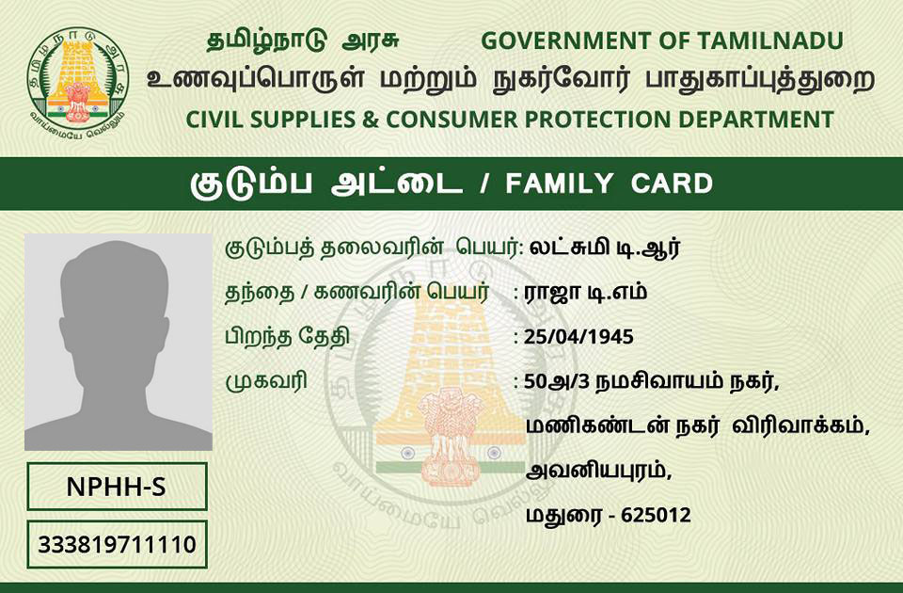
Priority household (PHH) card
Priority household (PHH) ration card - This card is issued to those households which meet the eligibility criteria set by the state governments. Every household which has a priority ration card is entitled to 5 kilograms of food grains per member every month.

Slide 4
Antyodaya (AAY) ration card
The Antyodaya ration card is issued to those households which fall under the 'poorest of poor' category. Those who have this card, are entitled to 35 kilograms of food grain every month.

Slide 5
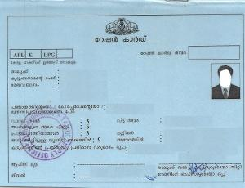
APL (Above Poverty line) ration card
The APL ration card was issued to households living above the poverty line.

Slide 6
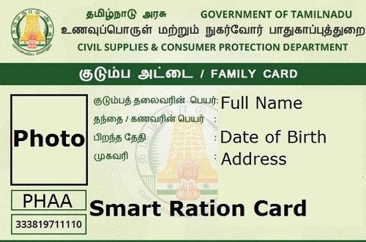
BPL (Below Poverty line) ration card
The BPL ration was for those households living below Poverty line.

Slide 7
AAY (Antyodaya) ration card
The AAY which is still in place was issued to poorest of poor households.
It must be noted here, APL, BPL and AAY cards were in use before the National Food Security Act was enacted in the country

Slide 8
THANK YOU

